Slide 1
Django Requirements
Python 3.0 or Higher
python --version
PIP
pip --version
Text/Code Editor/IDE – Notepad++, VS Code, ATOM, Brackets, PyCharm
Web Browser – Google Chrome, Mozilla Firefox, Edge

Slide 2
Check Django is installed or Not
django-admin --version

Slide 3
How to install Django
Separate Virtual Environment
Globally

Slide 4
Install Django in Separate Environment
Install Virtual Environment Wrapper
pip install virtualenvwrapper-win – This is used to install Virtual environment wrapper.
Create Virtual Environment (VE)
mkvirtualenv envname – This is used to create virtual environment. It will automatically activate environment.
Active VE
workon envname – This is used to activate environment.
Install Django in Created VE
pip install django – First activate environment then run the command to install django within active environment. You can also specify version pip install django==2.0

Slide 5
Django Project
A Django Project may contain multiple Project Application, which means a group of Application and files is called as Django Project.
An Application is a Part of Django Project.
SchoolProject
Registration App
Fees App
Exam App
Attendance App
Result App

Slide 6
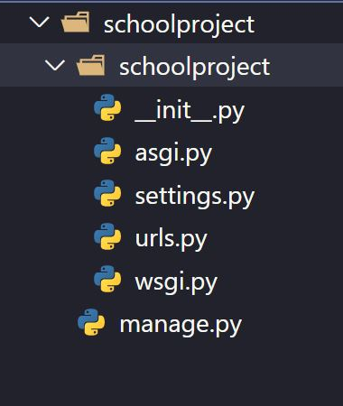
Create Django Project
Syntax: -
django-admin startproject projectname
Example:-
django-admin startproject schoolproject
schoolproject
schoolproject
__init__.py
asgi.py
settings.py
urls.py
wsgi.py
manage.py

Slide 7
Uninstall Django from Separate Environment
Active Virtual Environment (VE)
workon envname – This is used to activate environment.
Uninstall Django from VE
pip uninstall django – This is used to uninstall django.
Remove Virtual Environment
rmvirtualenv envname – This is used to remove virtual environment.
Uninstall Virtual Environment Wrapper
pip uninstall virtualenvwrapper-win – This is used to uninstall Virtual environment wrapper.

Slide 8
How to install Django
Separate Virtual Environment
Globally

Slide 9
Django Requirements
Python 3.0 or Higher
python --version
PIP
pip --version
Text/Code Editor/IDE – Notepad++, VS Code, ATOM, Brackets, PyCharm
Web Browser – Google Chrome, Mozilla Firefox, Edge

Slide 10
Check Django is installed or Not
django-admin --version

Slide 11
How to Install Django
pip install django – This is used to install Django.
For Version Specific
pip install django==2.0

Slide 12
How to Uninstall Django
pip uninstall django

Slide 13
Django Project
A Django Project may contain multiple Project Application, which means a group of Application and files is called as Django Project.
An Application is a Part of Django Project.
SchoolProject
Registration App
Fees App
Exam App
Attendance App
Result App

Slide 14
Create Django Project
Syntax: -
django-admin startproject projectname
Example:-
django-admin startproject schoolproject
schoolproject
schoolproject
__init__.py
asgi.py
settings.py
urls.py
wsgi.py
manage.py

